Slide 1
CTOS Annual Meeting 2018 Rome, November 14-17 2018
Italy

Slide 2
Destination Experience

Slide 3
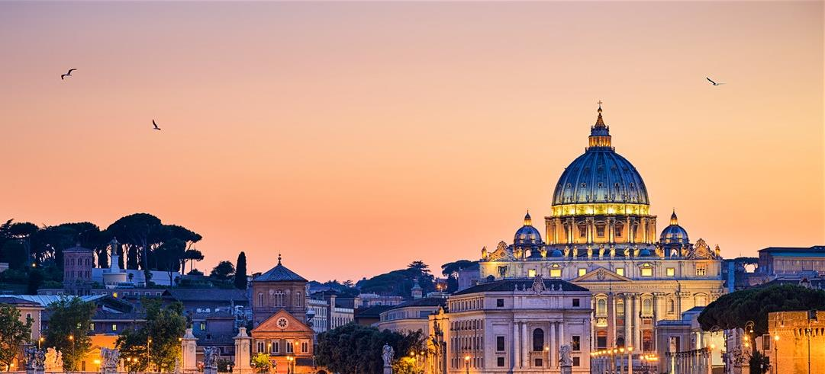
Rome

Slide 4
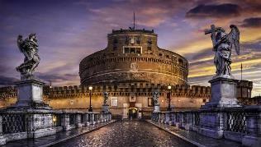
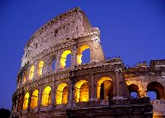
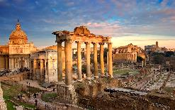
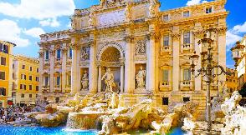
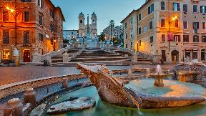
Destination Experience
Destination Experience
The capital of Italy, a land of ancient ruins and mysteries, the founding of Rome is enveloped in myth. According to the story, it takes its name from two brothers Romulus and Remus, a pair of twins who were reared by a wolf. The first city centre itself sprang up in 753 B.C on the Palatine hill which was built by Romulus after he killed his twin brother Remus! Nowadays, Rome is the country’s largest and most populous city. Situated on the banks of the Tiber, the city is located in the central-western part of the Italian peninsula, about 12 miles from the Mediterranean Sea. Known as “The Eternal City” thanks to its wealth of history, it is difficult to turn a corner without seeing one of the innumerable monuments that give Rome its grandiose and impressive architectural character. The heart of Catholicism, Rome is also home to the Vatican City where the Pope resides in this smallest nation of the world. The rich historic, artistic and religious background of Rome have made it an irresistible attraction and has put it among the most popular tourist destinations in the world!

Slide 5
Access and methods of transportation

Slide 6
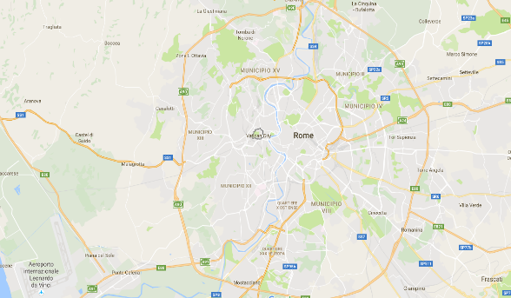
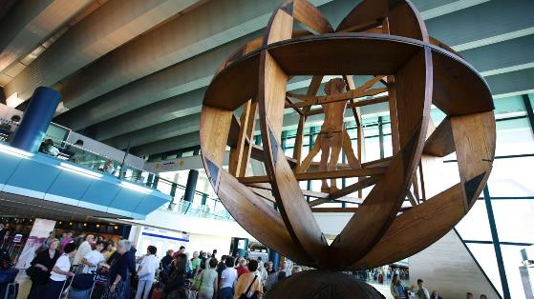
Access Rome
Description Rome Airport: Rome airport Fiumicino or Leonardo da Vinci airport of Rome is Italy’s first airport and Europe’s sixth where traffic volume is concerned. It lies 16 miles southwest of Rome and is linked to the city by train and by motorway.
Vatican
Downtown
Rome
FCO
Airport

Slide 7
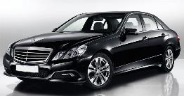
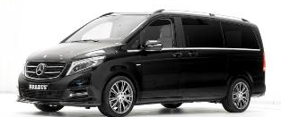
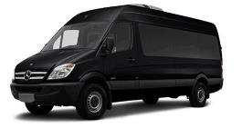
Individual Transfers chauffeur drive
All transfers are provided by a private vehicle with an English-speaking driver. Ovation Italy source chauffeur drive requirements from a selection of preferred chauffeur drive suppliers located in Italy who undergo constant monitoring on quality and service. There are a range of vehicles available, but predominantly we use Mercedes E class and Mercedes V class.
Mercedes E Class Capacity: 3 passengers, 2 with luggage on board
MercedesV Class Capacity: 6 passengers, 4 with luggage on board
Mercedes Sprinter Class Capacity: 8 passengers, 6 with luggage on board

Slide 8
Individual Transfers chauffeur drive
Costs from/to Fiumicino and Ciampino Airports:
One way transfer to/from airport by Mercedes E Class Sedan € 80+ 10% Vat
Extra stationing hours cost per Sedan per hour € 49+ 10% Vat
One way transfer to/from airport by Mercedes V Class/Vito/Viano 6 passengers Minivan € 95+ 10% Vat
One way transfer to/from airport by Mercedes Sprinter Clas 8 passengers Minivan € 104+ 10% Vat
Extra stationing hours cost per vehicle per hour € 62+ 10% Vat
For services between 08:00pm and 08:am 20% supplement applied
Costs from/to Termini Railway Main Station:
One way transfer to/from airport by Mercedes E Class Sedan € 50+ 10% Vat
Extra stationing hours cost per Sedan per hour € 49+ 10% Vat
One way transfer to/from airport by Mercedes V Class/Vito/Viano 6 passengers Minivan € 58+ 10% Vat
One way transfer to/from airport by Mercedes Sprinter Clas 8 passengers Minivan € 72+ 10% Vat
Extra stationing hours cost per vehicle per hour € 62+ 10% Vat
For services between 08:00pm and 08:am 20% supplement applied

Slide 9
Experiences

Slide 10
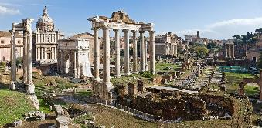
Imperial Rome
Description: The journey into ancient times starts by walking into the largest amphitheatre in the ancient world the Colosseum. During the visit we shall see where gladiators and fierce animals challenged each other unto death, for the pleasure of the Emperor and the public. We then walk through what was then the center and heart of ancient Rome-the Forum. We see the Senate House, where the destiny of Rome and most of the Western world was decided. We continue to the Arch of Titus, which commemorates the Emperor’s victory over Jerusalem in 72 A.D and finally admire the Arch of Constantine, commemorating the conversion of pagan Rome to Christianity. To complete this journey through ancient Rome times, we drive by the famous Circus Maximum, and the Theater of Marcello (a forerunner of the Colosseum)...our tour ends in Piazza Venezia, to admire the huge marble monument to King Victor Emmanuel II, built at the turn of the last century.
Cost pp € 52,00 – based on minimum guaranteed of 25 participants
The cost includes:
27 passenger motorcaoch based on 4 hours
Local guide based on 4 hours and up to 25 guests
Admissions to Colosseum and Roman Forums
Head sets

Slide 11
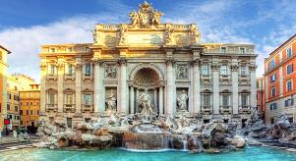
Pantheon, Trevi Fountain and Spanish steps
Description: This walking experience has been designed to cover some amongst the most interesting sites of Rome. Our first stop will be the Trevi Fountain, a baroque fountain designed in 1762 by Nicola Salvi famous for Federico Fellini´s movie "La Dolce Vita ". It is also known for the legend of the three coins: Throw three coins and make three wishes... It is believed that this act will ensure your return to the Eternal City. We continue and make our way through the alleys until we arrive to the Pantheon, one of the greatest and best preserved monuments of ancient Rome. Built by Agrippa in 27 B. C, the monument is a great example of architecture, built as a Pagan Temple it was turned into a Church in 609 by Pope Bonifacio IV. Our walk continues to Piazza Colonna where we see the marble column built by the Roman Senate in memory of the Emperor Marco Aurelio. Then we proceed to the Spanish Steps, the hour glass-shaped square is one of the most popular spots in the city. The Spanish Steps were built in 1726 by Francesco De Sanctis. At the top of the stairs you will admire an Egyptian obelisk, the so called Obelisco Sallustiano, as well as the church Trinità dei Monti with a 16th century façade by Carlo Moderno. Ample free time will be allocated to browse in the famous streets surrounding Piazza di Spagna.
Cost pp € 39,00 – based on minimum guaranteed of 25 participants
The cost includes:
27 passenger motorcaoch based on 4 hours
Local guide based on 4 hours and up to 25 guests
Head sets

Slide 12
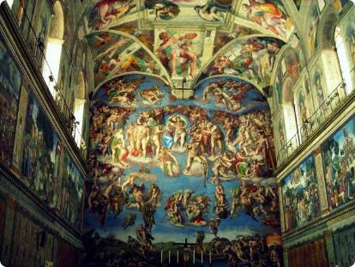
Vatican Museums and Sistine Chapel
Description: The Vatican City is the world's smallest sovereign state with one of the richest art collections in the world housed inside the Vatican Museums. The Vatican Museums contain masterpieces of painting, sculpture and other works of art collected by the popes through the centuries. The Museums include several monumental works of art, such as the Sistine Chapel and the Raphael Rooms. You will visit the Candelabra Gallery, the Tapestry Gallery and the Geographical Map Gallery. You then reach the world-renowned Sistine Chapel, built in 1473, by the order of Pope Sistus IV from whom it derives its name. Your visit is highlighted by the masterpieces of Michelangelo, who spent 4 years painting the Chapel ceiling with frescoes depicting scenes from the Old Testament, including the incredible scene of the Creation. You will then continue your visit inside the Basilica of Saint Peter and see one of the most astonishing structures, perhaps in the entire world. Not only is this the world's largest church, but it is also the 'heart and soul' of Catholicism, and the repository of some of mankind's most glorious artistic creations: the "Pietà” sculpture by Michelangelo, to mention but one. Finally you will walk through the spectacular St. Peter's square , one of the largest and most beautiful squares in the world.
Cost pp € 59,00 – based on minimum guaranteed of 25 participants
The cost includes:
27 passenger motorcaoch based on 4 hours
Local guide based on 4 hours and up to 24 guests
Admissions to Vatican Museums and Sistine Chapel
Head sets

Slide 13
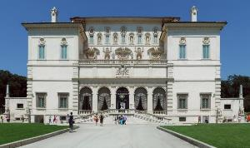
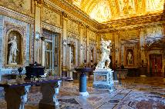
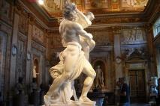
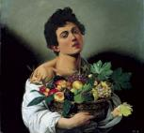
Borghese Gallery tour
Description: This magnificent temple of art was created by the wealthy cardinal Scipione Borghese in the early 1600’s to house his world renowned private collection of masterpieces by Raffaello, Tiziano, Bernini, Caravaggio, just to name a few. The Cardinal created a home for himself and his art collection in the mist of Rome’s most beautiful two hundred acre park. Villa Borghese was built with the intention of combining art and nature in an incomparable setting. The building later became the home of Napoleon’s sister, Pauline, when she married a member of the Borghese family. The famous sculptor Antonio Canova immortalized Pauline in an extraordinary marble sculpture of her as Venus, which is displayed at the Gallery. In the year 1901, the Borghese family gave its villa and art collection as a gift to the city of Rome which then made it a museum with all its wonderful collection.
Opening times:
Tuesday – Sunday (closed on Monday)
09:00am – 11:00am
11:00am – 01:00pm
01:00pm – 03:00pm
03:00pm – 05:00pm
Cost pp € 52,00 – based on minimum guaranteed of 25 participants
The cost includes:
27 passenger motorcaoch based on 4 hours
Local guide based on 3 hours and up to 25 guests
Admissions to Borghese Gallery
Head sets

Slide 14
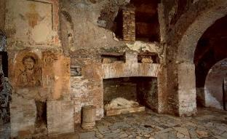
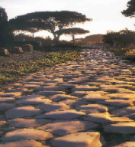
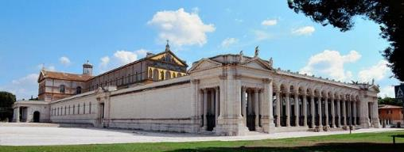
Catacombs Saint Paul Basilica and Old Appian way
Description: This unusual tour takes us to the interesting but lesser known sights of Rome located just outside the City Walls. We drive along the Appian Way, which is the oldest paved road in the world and will lead us towards the Catacombs. The Catacombs consist of an intriguing maze of underground tunnels hollowed out of volcanic rock, where the early Christians who were persecuted by the Romans had to practice their religious rites and bury their dead in secret. We will have the opportunity to walk through these dark and narrow tunnels to fully experience their mysterious and enchanting atmosphere. The decorations found throughout the Catacombs represent precious samples of early Christian art, such as frescoes portraying biblical scenes and those representing the themes of Baptism and Resurrection. Through the Gate of St. Paul, we continue on to the Basilica dedicated in his name. Visiting St. Paul’s Outside the Walls, the largest Basilica in Rome after St. Peter’s, we see the charming cloisters before heading back to Rome along a section of the Old Appian Way. One of the first ancient Roman military roads that connected Rome to Naples and Brindisi, we are able to see the huge slabs that originally paved the entire road’s length and the several surviving monuments that lined its way…all of this with a lovely background of cypresses and umbrella pines.
Cost pp € 47,00 – based on minimum guaranteed of 25 participants
The cost includes:
27 passenger motorcaoch based on 4 hours
Local guide based on 4 hours and up to 25 guests
Admisisons to Catacombs
Head sets

Slide 15
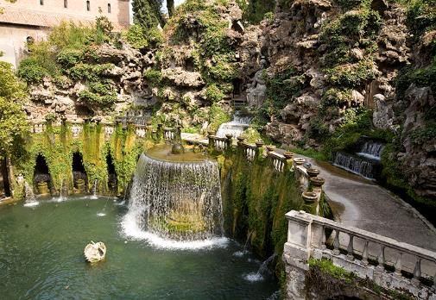
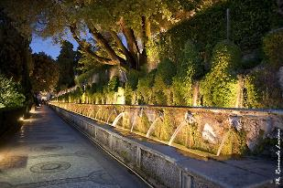
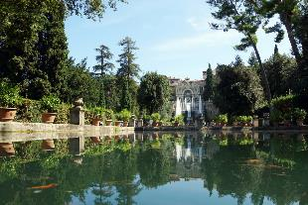
Half Day tour of Villa D’Este in Tivoli
Description: A short ride through the Roman countryside and its olive groves, you reach Tivoli, a famous resort for Romans for more than 2000 years. You will visit Villa d'Este, a beautiful private Renaissance mansion, once the home of Cardinal Ippolito d'Este. Using this villa as a pleasant country retreat, he spent years creating the unbelievable terraced gardens, filled with hundreds of fountains and waterfalls, grottoes and ancient trees. It is all artistically composed to create an unforgettable effect with simple architecture that contrasts with the elaborate geometric design of the gardens descending in a series of terraces, that are certainly some of the finest to be found both inside or outside of Italy.
Cost pp € 59,00 – based on minimum guaranteed of 25 participants
The cost includes:
27 passenger motorcaoch based on 4 hours
Local guide based on 3 hours and up to 25 guests
Admisisons to Villa D’Este
Head sets

Slide 16
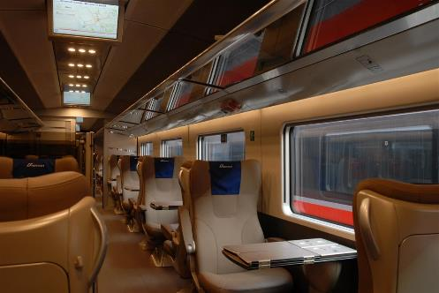
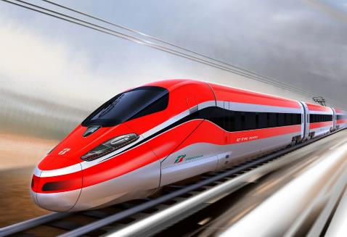
Full Day Excursion to Florence by high speed train
Italy’s rail system has long been hailed as a marvel of excellent engineering. Over the last few years, the railways have been updated to accommodate a greater volume of high-speed trains, tailored to Italy’s traveling business people. As the train winds through hills, over water, and through mountains, the scenery along the way is an experience in itself. Travel from Rome to Florence on the modern high speed trains and reach the city center of this Renaissance city after one hour and Half. Experience a guided tour of Florence including a visit to the Academy of Fine Arts to see the famous statue of the David by Michelangelo.
.

Slide 17
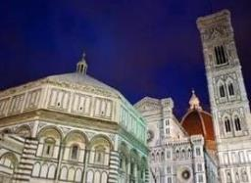
Full Day Excursion to Florence by high speed train
No single city has contributed as much to the evolution of modern times. Countless glorious buildings, immortal sculptures and paintings bear witness to the city's immense importance in the history of Italian art. The city reached the height of its prosperity under the famous Medici Family. Geniuses like Dante Alighieri, Machiavelli, Giotto and Michelangelo found inspiration on the banks of the Arno and contributed to making Florence "the largest open air museum" in the world. Today it is the home of gold and silver smiths, fashionable boutiques and leather galore - a world-renowned shopper’s delight, ready to satisfy every taste. You may choose from a wide selection of possible tours in Florence at end of which ample free time will be allocated for wondering around on your won. Enjoy dinner at a traditional restaurant before making your way back to Rom on high speed train
Costs pp € 158,00 – based on minimum guaranteed of 25 participants
The cost includes:
Round-trip transfer Rome train station by 27 passenger motorcoach
Local staff travelling with the group based on 10 hours
Return high speed train second class train tickets, per person
Local guide based on 3 hours and up to 25 guests
Head sets

Slide 18
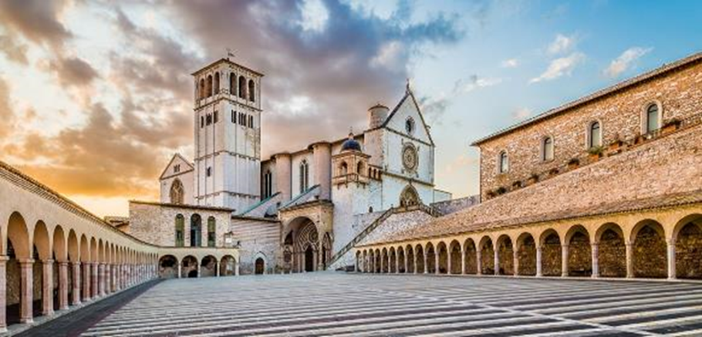
Full Day Excursion to Assisi
Assisi, from the Latin: Asisium is a town and commune of Italy in the province of Perugia in the Umbria region, on the western flank of Monte Subasio. It was the birthplace of St. Francis, who founded the Franciscan religious order in 1208, and St. Clare (Chiara d'Offreducci), the founder of the Poor Sisters, which later became the Order of Poor Claris after her death. The 19th-century Saint Gabriel of our Lady of Sorrows was also born in Assisi. The town is dominated by two medieval castles. The larger, called Rocca Maggiore, with a massive presence meant to intimidate the people of the town: it was built by Cardinal Albornoz (1367) and reconstructed by Popes Pius II and Paul III. The smaller of the two was built much earlier, in the Roman era. However, not all of it stands, and only a small portion and only three towers are open to the public. UNESCO collectively designated the major monuments and urban fabric of Assisi as a World Heritage Site.
Cost pp € 68,00 – based on minimum guaranteed of 25 participants
The cost includes:
Round-trip transfer Rome Assisi by 27 passenger motorcoach based on 8 hours
Local staff travelling with the group based on 8 hours
Local guide based on 3 hours and up to 25 guests
Head sets

Slide 19
Full Day Excursion to Naples and Pompeii
Escape the hustle and bustle of Rome for the day and take a trip along the Mediterranean Coast, travelling south down the highway towards the ancient archaeological site of Pompeii. We take the main road south, passing alongside the famous Monte Cassino Abbey of World War II fame. When we reach the Bay of Naples we shall enjoy expertly guided tours through the unbelievably well preserved remains of Pompeii, where all life was suddenly stopped by an eruption of Mt. Vesuvius in 79 AD. Today, Pompeii represents one of the most important archaeological sites in the world because it provides a complete picture of the life of an ancient Roman town. After lunch we then leave Pompeii and reboard our motorcoach to drive to Naples. Upon arrival in Naples, we enjoy a typical Neapolitan coffee before walking in to gather your strength for a walk in the city center, where you can admire famous squares, including Piazza del Plebiscito, and Castle Angioino.
Cost pp € 150,00 – based on minimum guaranteed of 25 participants
The cost includes:
Round-trip transfer Rome Naples and Pompei by 27 passenger motorcoach based on 10 hours
Local staff travelling with the group based on 10 hours
Local guide based on 8 hours and up to 25 guests
3 courses pre-selected menu for lunch to a local restaurant
Admissions to Excavations in Pompeii
Head sets

Slide 20
NOTES
For any information or detail you might need please do not hesitate to contact us:
Maria Grazia Paolelli
Andrea Brunetti
Ovation Italy
Rome Office
Via della Ferratella in Laterano 41, 00184 Rome
Tel: + 39 06 70495693
Fax : + 39 06 709 96 292
ctostour@ovationdmc.com

Slide 21
Thank y
u!
Rome Office
Via della Ferratella in Laterano 41, 00184 Rome
ovationdmc.com/italy

