Slide 1
Giant Cell Tumor of Bone in paediatric patient

Slide 2
Presentation
17 years old (currently) female with significant right shoulder pain and rihgt upper extremity weakness 07/2009
T1 vertebral mass with destruction of vertebral body; extradural mass
S/p T1 anterior corpectomy and spinal cord decompression 07/17/2009
Recurrent tumor on follow up scans in 10/2009

Slide 3
GCTB of Bone
S/p repeat resection with C7/T2 laminectomy with tumor excision 10/22/2009
S/p adjuvant Ifosfamide + Adriamycin 11/2009 to 02/2010 with poor response
Recurrent disease on follow-up scans in 03/2010 with neck pain and right upper extremity weakness
What would you do?

Slide 4
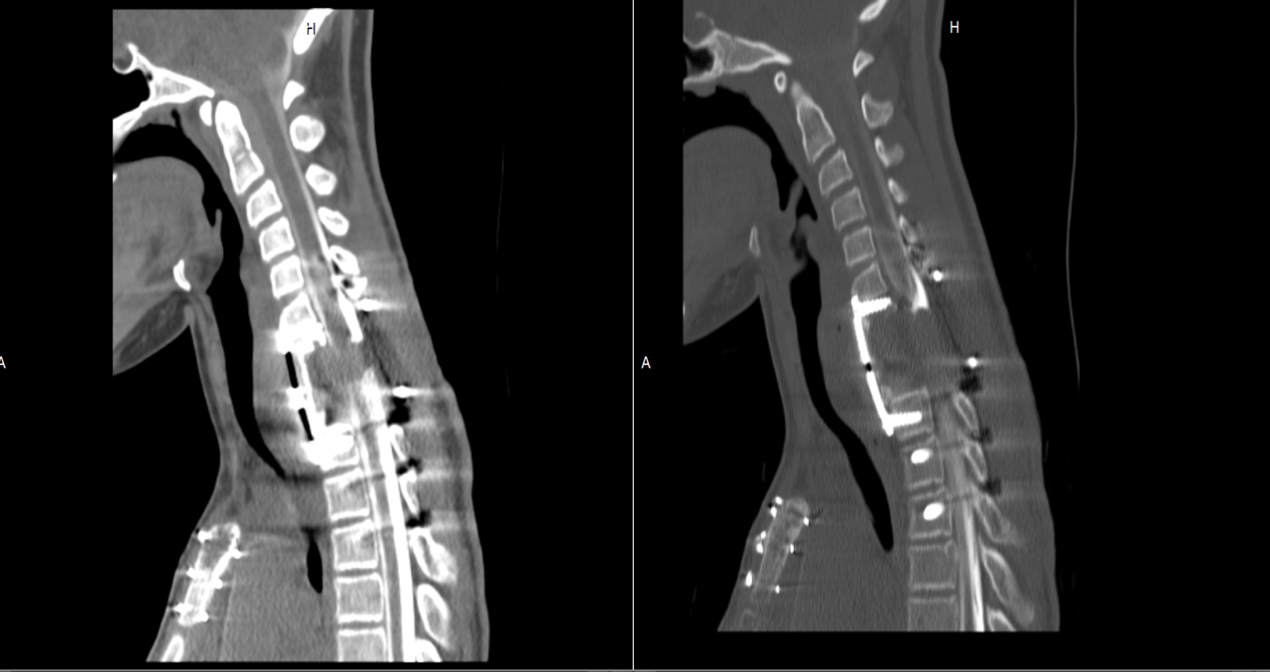
At Sarcoma Oncology Center
Patient enrolled in clinical trial of Denosumab in April 2010
Pre-treatment CT scans of the cervical spine from April of 2010, an extensive soft tissue C6 to C7

Slide 5
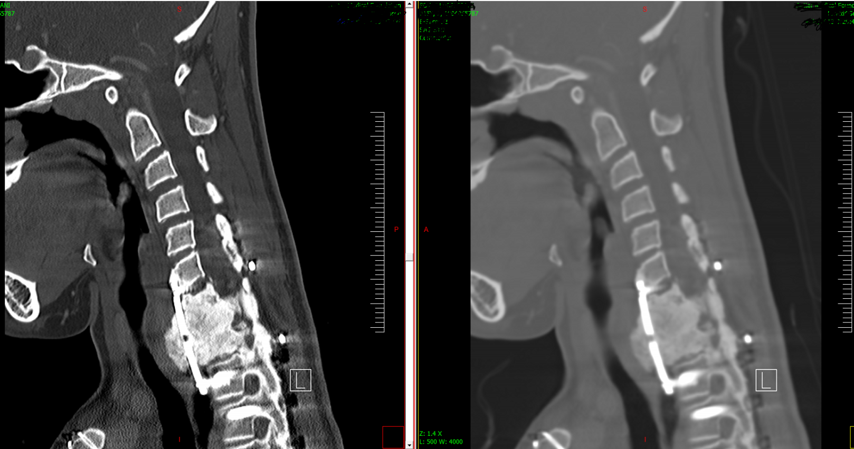
Response to Denosumab
CT scan of the cervical spine performed in April 2013, showing development of calcification and new bone formation along the surgical site.

