Slide 1
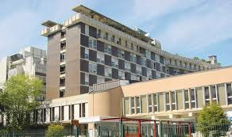
MALIGNANT MYOEPITHELIOMA OF THE SOFT TISSUE: A MONOINSTITUTIONAL SYSTEMATIC REVIEW OF A CHALLENGING DIAGNOSIS AND ANALYSIS OF CLINICAL FEATURES.
Marco Fiore
marco.fiore@istitutotumori.mi.it
Notes:
I would like to thank you the scientific commitee for the opportunity to present our study on myoepithelioma of soft tissue.
Myoepithelioma is a rare diagnosis, and actually many recent data contributes to raise the interest upon this entity

Slide 2
Background

Slide 3
Mixed tumors --- Myoepithelial tumors
Salivary Glands
Breast
Soft Tissues
Skin
Viscera
Bone
Notes:
Myoepithelial tumors are described in many sites, including salivary and breast. Presently not uniform treatment strategy is used among these entities, also because of referall to different specialists

Slide 4
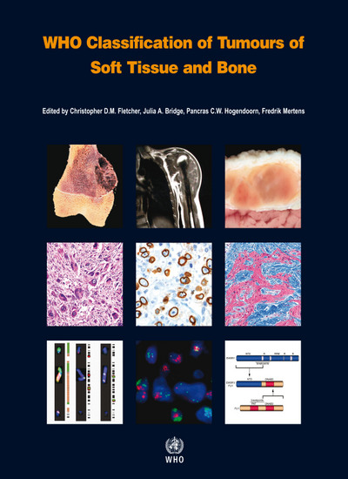
Myoepithelioma/myoepithelial carcinoma/mixed tumour
Similar to counterparts in salivary glands (morphology / ICC)
Parachordoma (synonym)
20% pediatric (>> myoepithelial carcinomas)
Soft tissues: Limbs, Girdles
Rarely, bone / visceral
Sometimes primarily in the skin
Broad-spectrum keratins
S100
Calponin
EMA (66%)
GFAP (50%)
SMA
p63
CD34 / Desmin / Brachyury → negative
Prognostic factors ??
“Malignant” myoepithelioma:
Cytologic atypia
High mitotic rate
…Difficult to predict outcome
EWSR1 rearrangement (45%)
EWSR1-POU5F1
EWSR1-PBX1
Rare:
EWSR1-ZNF444
FUS
… ATF1
16%
C.R. Antonescu et al. Gene Chromosomes and Cancer 49: 1114-1124 (2010)
Notes:
Concerning the classification of soft tissue and bone tumors, Myoepithelioma definition has been refined in last edition of WHO, including a broad spectrum of clinical presentations like pediatric tumors, skin tumors, bone/visceral lesions. Still in the definition of myoepithelioma it is stressed the similar counterpart in salivary glands.
Immunocitochemistry is characterized by markers of myoepithelial cells that include both epithelial and muscolar markers
While, in a definite proportion of cases translocations have been described, mainly involvig EWS gene
As far as pathologic prognostic factors, we have very poor data – presently pathologists define “malignant myoepithelioma” a lesion with cytologic atypia and high mitotic rate, but anyway outcome is difficult to predict.

Slide 5
Myoepithelioma/myoepithelial carcinoma/mixed tumour
Similar to counterparts in salivary glands (morphology / ICC)
Parachordoma (synonym)
20% pediatric (>> myoepithelial carcinomas)
Soft tissues: Limbs, Girdles
Rarely, bone / visceral
Sometimes primarily in the skin
Differential Diagnosis
Extraskeletal myxoid chodrosarcoma → NR4A3
Ossifying fibromyxoid tumor → PHF1
Chordoma → brachyury
Epithelioid MPNST
Sclerosing epithelioid fibrosarcoma → MUC4
Proximal-type epithelioid sarcoma
(Pratical Soft Tissue Pathology: A Diagnostic Approach
by Jason L. Hornick
1st edition published by Elsevier)
“Something-Epithelioid Sarcoma”
Notes:
Main differential diagnosis includes mainly extraskeletal myxoid chondrosarcoma and other rare sarcomas with epithelioid cells
We decided to review our series of myoepithelioma, trying to outline only on lesions arising within the soft tissue and excluding skin lesions and pediatric tumours, to limit the possible confounding factors in the analysis.

Slide 6
Methods (1)
Patients affected by:
myoepithelioma of soft tissue
malignant myoepithelioma
parachordoma
extraskeletal myxoid chondrosarcoma
sclerosing epithelioid fibrosarcoma
and surgically treated at INT since 1999 were retrieved from prospective STS institutional database
All cases underwent pathologic review for confirmation or differential diagnosis with myoepithelioma
Notes:
We reviewed all consecutive patients surgically treated at our institution for myoepithelioma, and we looked also to all extraskeletal myxoid chondrosarcoma and sclerosing epithelioid fibrosarcoma.
A systematic pathologic review was ruled out to confirm diagnosis.

Slide 7
Methods (2)
FISH:
EWSR1, FUS, NR4A3, PBX1, POU5F1, ZNF444, PHF1 and ATF1 gene status was assessed by Dual color break apart FISH experiments.
Commercial probe were employed for EWSR1 and FUS (Visys).
The remaining FISH experiment were performed with FISH mapped in house made BAC probes (CHORI).
RNA-sequencing (NGS)
Performed when adequate fresh/frozen tissue was available and Sanger Sequencing was also used to confirm NGS data.
Notes:
FISH analysis of EWSR1 gene, FUS gene and the main known companion genes was performed, as well as FISH for NR4A3 to exclude diagnosis of EMC in all cases.
We also performed RNA sequencing by NGS in the cases with adequate fresh/frozen tissue available.

Slide 8
Results

Slide 9
Myoepithelioma
Extraskeletal Mixoid ChondroSa
Sclerosing Epithelioid Fibrosarcoma
15
41
11
4
FISH
EMC
EWS-NR4A3
EWS-NR4A4
TAF15-NR4A3
TAF15-NR4A4
1
Ossificans Fibromixoid Tumor
NGS
EPC1-PHF1
Notes:
We had overall 67 patients distributed as shown in the figure.
Among the myoepitelioma group, 5 patients dropped out after FISH analysis and in 1 case after NGS analysis

Slide 10
Myoepithelioma
Extraskeletal Mixoid ChondroSa
Sclerosing Epithelioid Fibrosarcoma
15
41
11
10
2
1
NGS
EWS-PBX3
Myoepithelioma
FISH
NR4A3 negative
NR4A3 negative
13
Notes:
While 10 patients were confirmed to be myoepithelioma
2 patients out of the EMC were also included based on FISH analysis
And 1 Sclerosing epitheliod fibrosarcoma was included based on NGS finding
Finally we had 13 cases of confirmed myoepithelioma

Slide 11
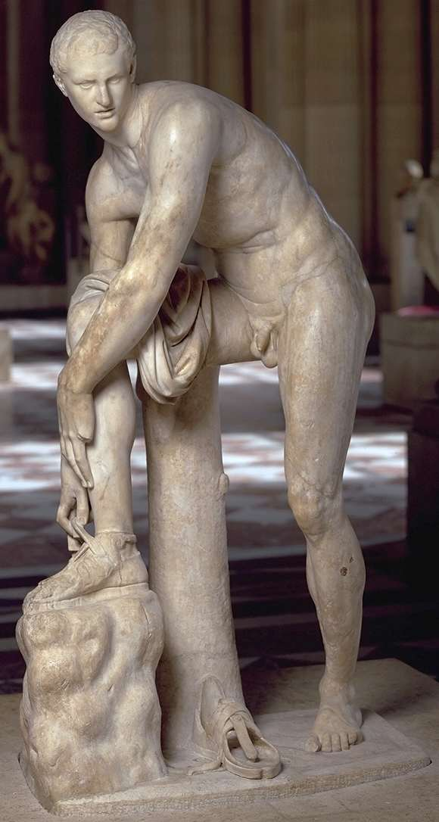
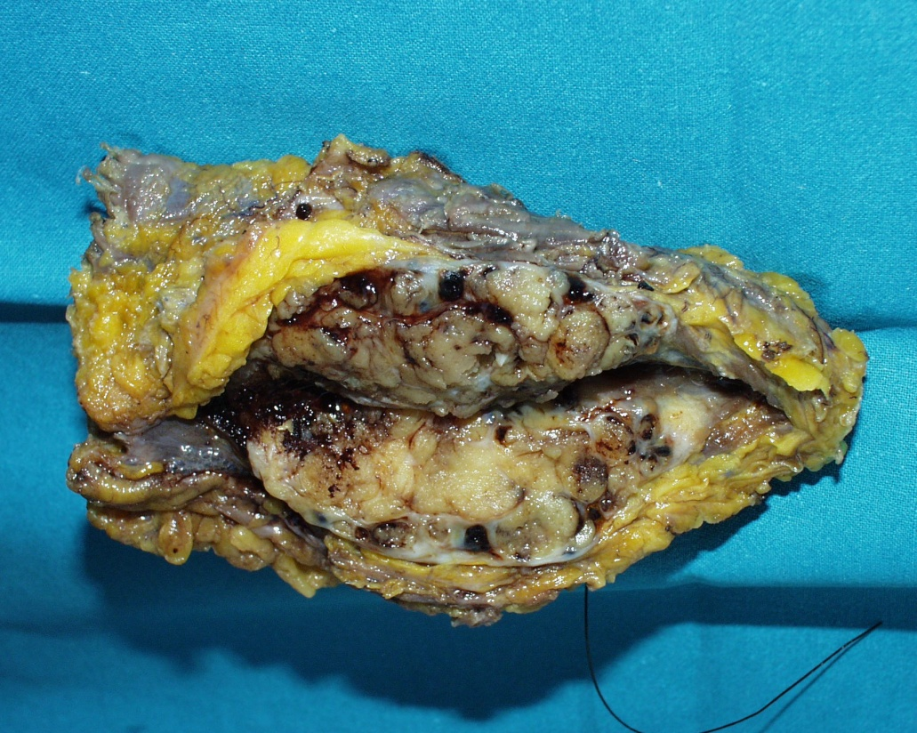
Confirmed Myoepithelioma # 13 patients
4 / 9
Primary / Recurrent: 12 / 3
Median Age : 42 yrs (range 19 -77)
Median Size: 5 cm (range 2 - 32)
Extremity 33%, Girdles 33%, Hand/foot 27%, Trunk 7%
Notes:
These are the clinical characteristics of confirmed patients
Median age was around 40 years,
Median tumor size was 5 cm with a wide range
Up to 60% of cases were located in surgically critical anatomic site like girdles and distal extremity

Slide 12
Immunophenotype profile of the analyzed series
Notes:
In this figure you can see the immunophenotype profile of the confirmed cases, that reproduced already published data with positivity of S100, keratins and muscolar markers.

Slide 13
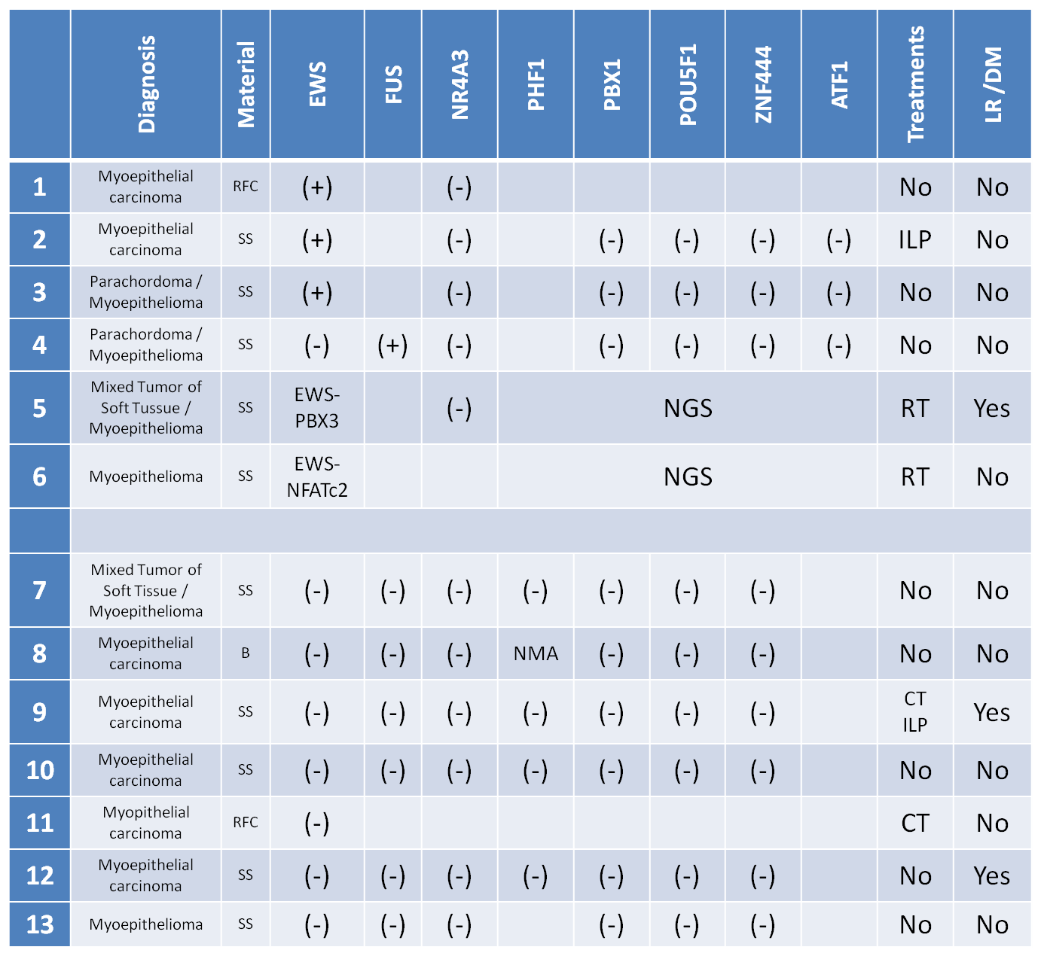
FISH / NGS- based Molecular Profiling of 13 Myoepithelioma of Soft Tissues
Myoep. Carcinoma
Myoep. Carcinoma
Myoepithelioma
Myoepithelioma
Myoepithelioma
Myoepithelioma
Myoepithelioma
Myoep. Carcinoma
Myoep. Carcinoma
Myoep. Carcinoma
Myoep. Carcinoma
Myoep. Carcinoma
Myoepithelioma

Slide 14
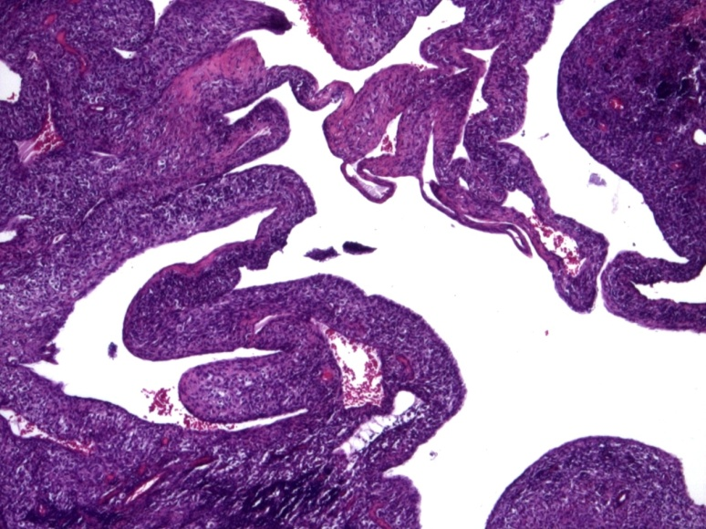
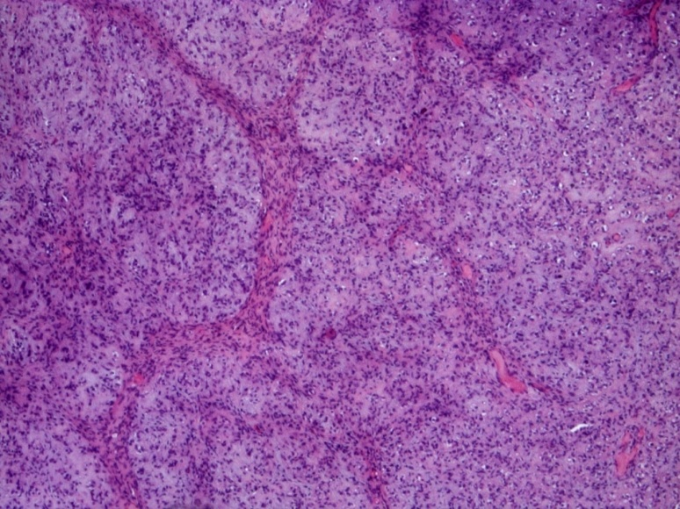
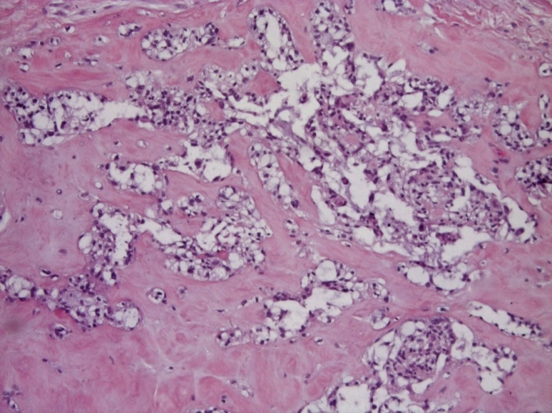
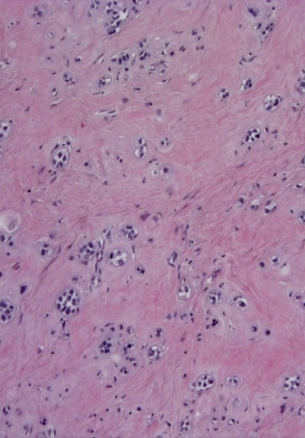
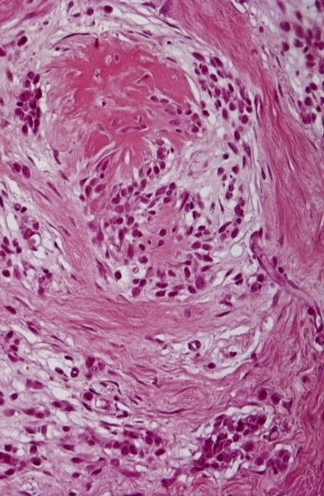
EWS/FUS positive myoepithelioma cases
2
EWS
3
EWS
5
EWS-PBX3
6
EWS-NFATc2
Variable growth pattern: cystic cavity, nodular growth, hyalinized stroma overgrowth, giant rosettes into collagenous stroma
Notes:
variable growth pattern with cystic cavity reminiscent of synovial sarcoma (2 ),nodular growth ( 3 ), overgrowth of hyalinized stroma (5, 6), and giant rosettes embedded into collagenous stroma reminiscent of low-grade fibromixoid sarcoma (6).

Slide 15
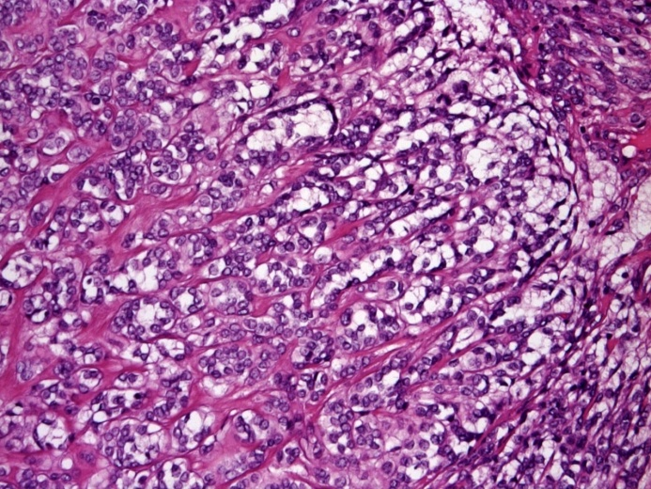
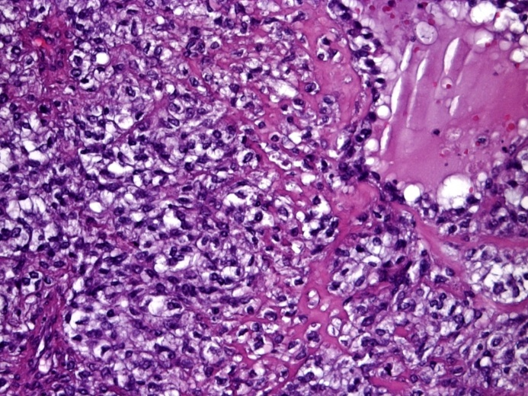
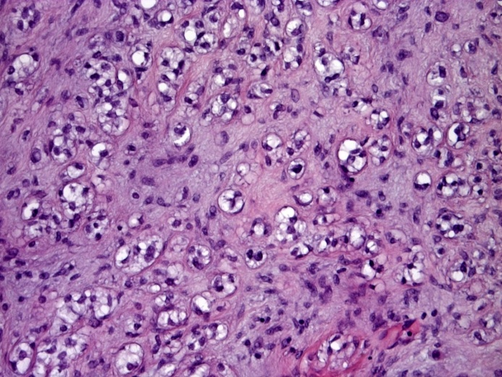
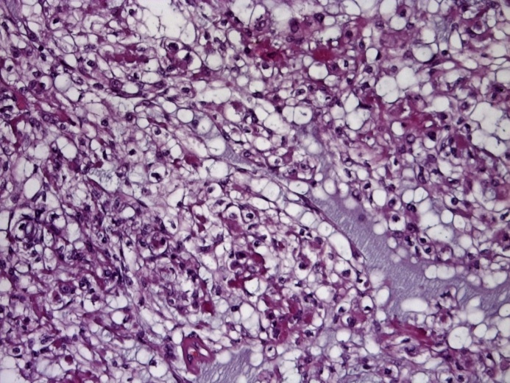
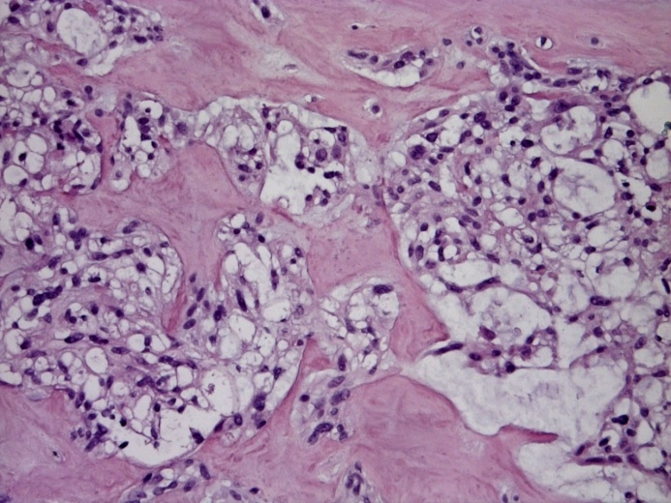
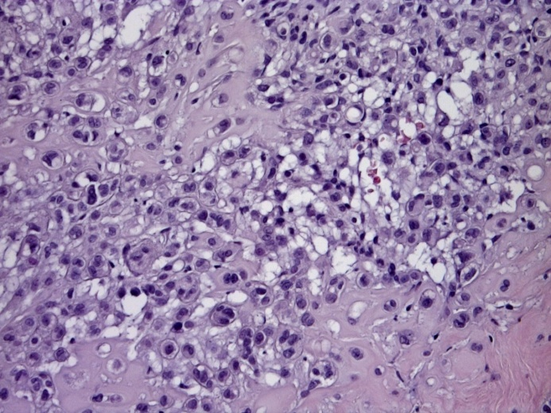
EWS/FUS positive myoepithelioma cases
1
EWS
2
EWS
3
EWS
4
FUS
5
EWS-PBX3
6
EWS-NFATc2
Epithelioid cells arranged in cords, solid clusters, interspersed , in ductules embedded in myxoid stroma, or large nests
Notes:
Mioepitel positivi letizia, pensallorto, teresi, castelli, pleitzer, trento
All the cases showed varying proportion of epithelioid cells arranged in cord (1), solid clusters(2), or interspersed (3), or forming ductules embedded in myxoid stroma (4), or large nests.(5 ,6)

Slide 16
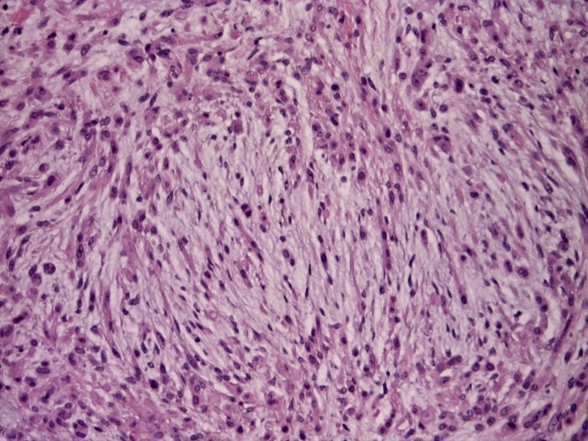
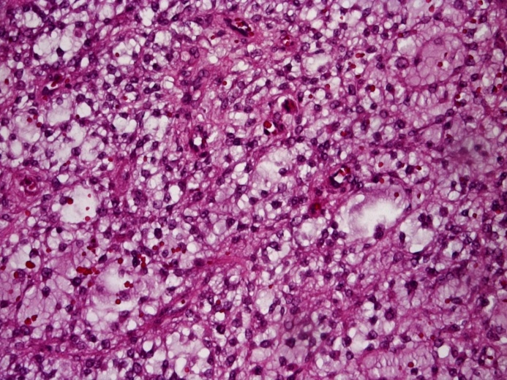
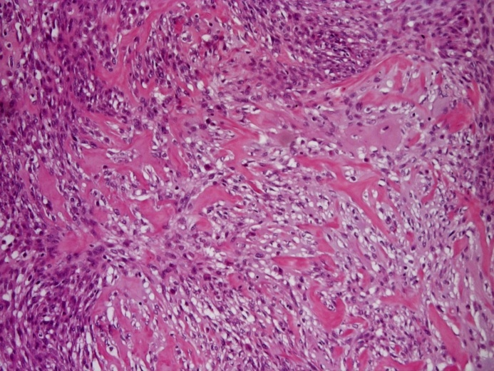
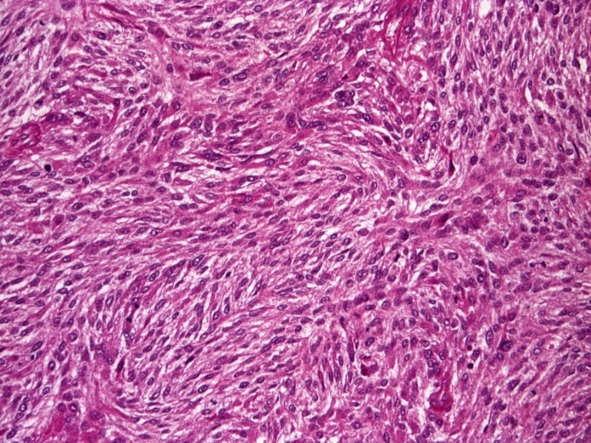
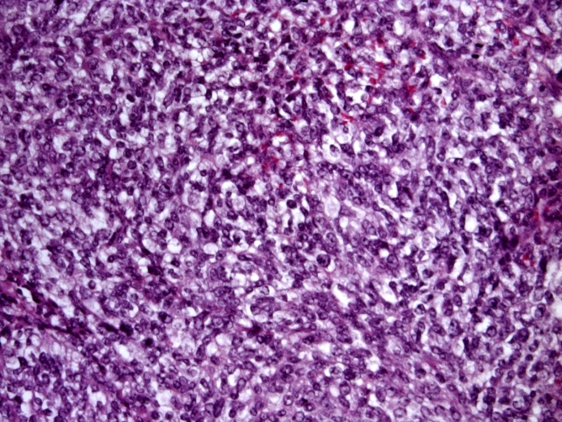
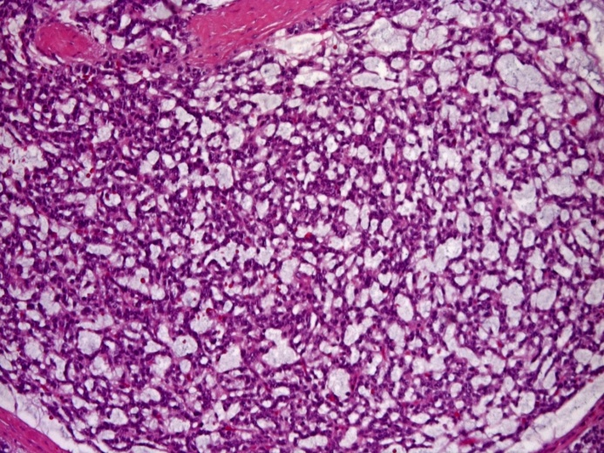
EWS/FUS negative myoepithelioma cases
7
9
10
11
12
13
Epithelioid/clear cell component with reticular pattern, or prevalent spindle cell component
Notes:
Mioepitel negativi : codoro, di chiara, placidi, porcile, tappi, renna
The negative cases exhibited again epithelioid/clear cell component in three cases (9,12,13) with reticular pattern suggestive of EMC in case 13, and prevalent spindle cell component in the remaining cases (7,10,11)

Slide 17
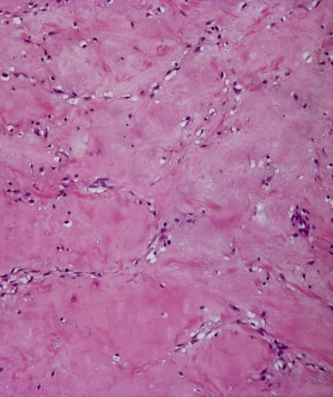
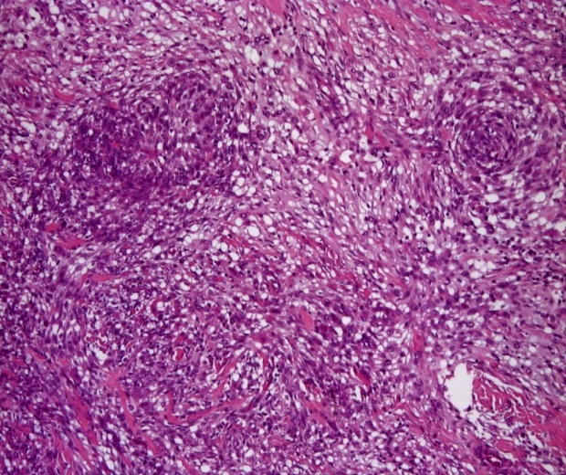
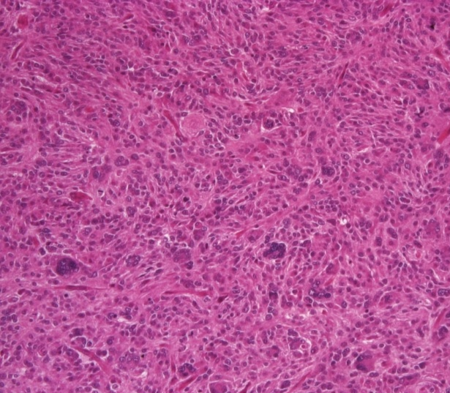
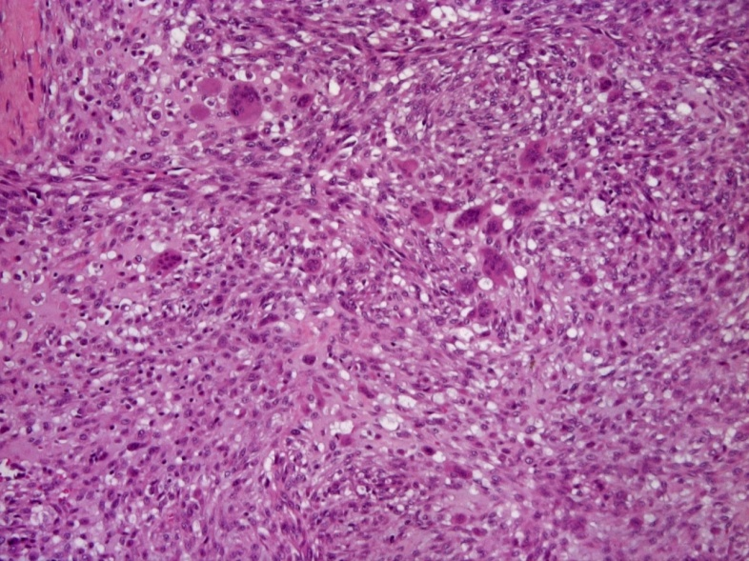
EWS/FUS negative myoepithelioma cases
10
11
Large hypocellular hyalinized areas, giant cells (multinucleated or osteoclast-like )
12
Notes:
Placidi, porcile, tappi
Numerous worls and large ipocellular hyalinized areas characterized case 10, while case 11 and 12 exhibited numerous giant cells multinucleated in the former and and osteoclast-like in the latter .

Slide 18
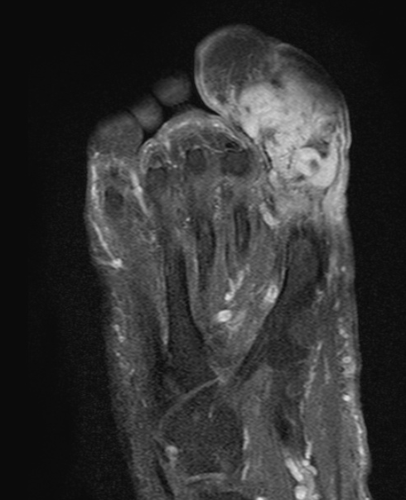
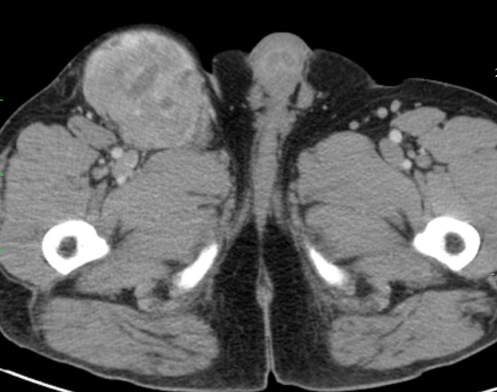
5
Myoepithelial Carcinoma – EWS pos
SYT negative
Surgery + RT
LR and DM (loco-regional) at 160 mos
NED at 170 mos

Slide 19
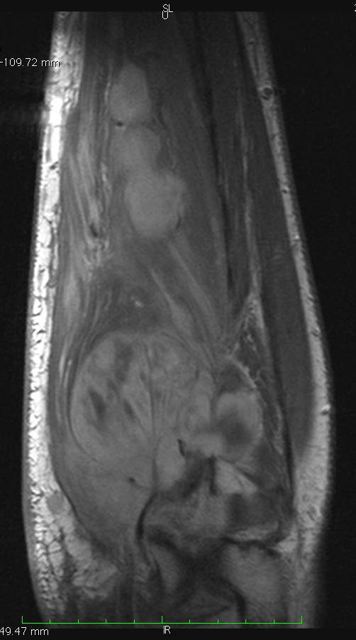
9
Myoepithelial Carcinoma - EWS FUS neg
+ Epi / Ifox 3 courses → SD
+ ILP → transitory MR → PD

Slide 20
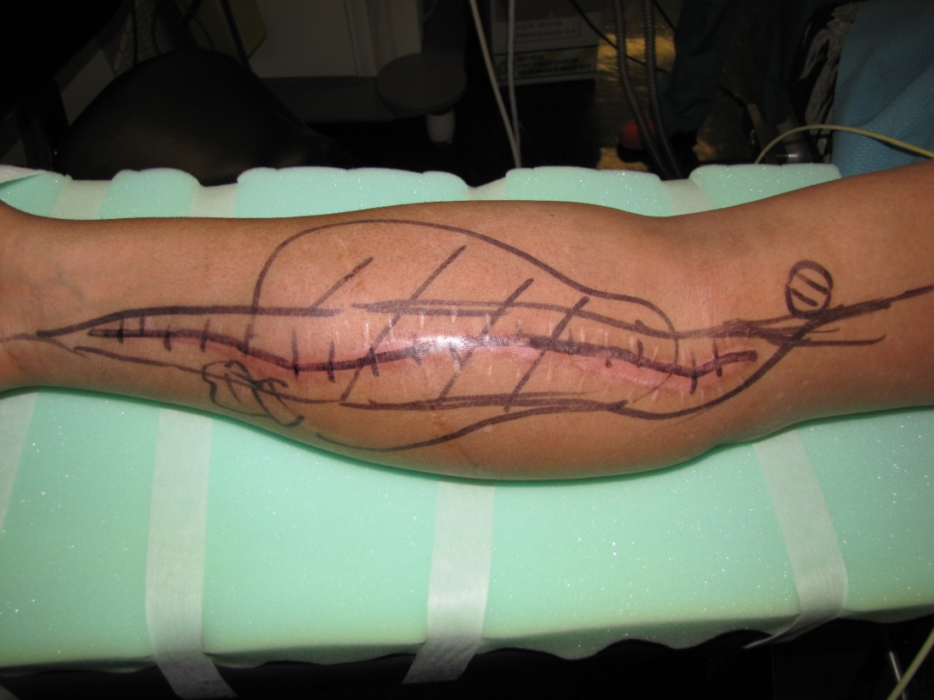
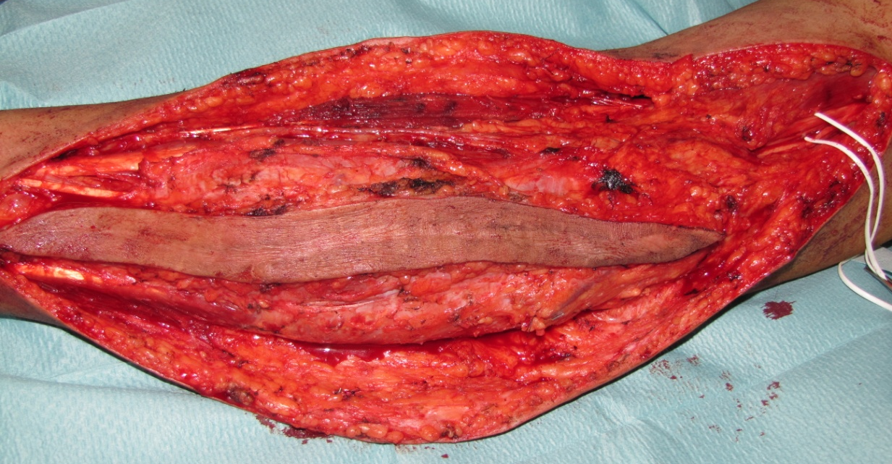
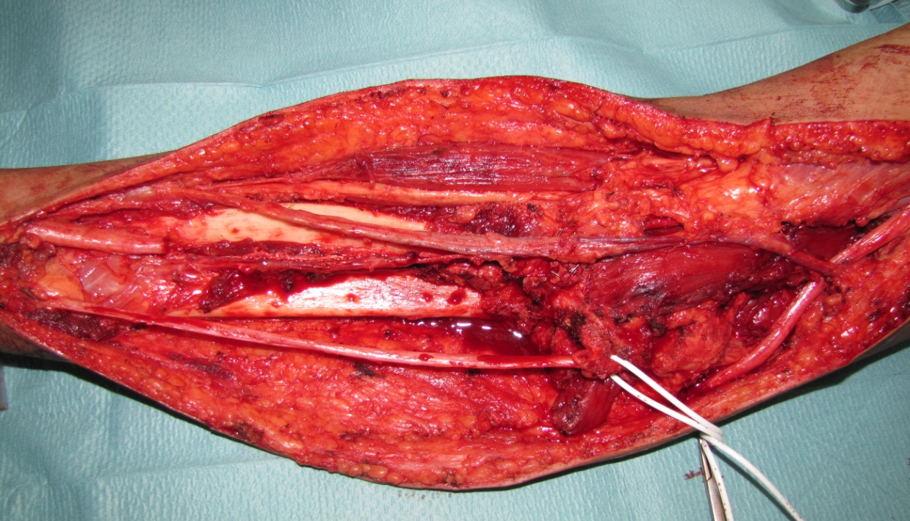
LR and DM at 3 mos
DOD at 9 mos

Slide 21
Outcome
5-yr LR CCI → 13%
5 yr DM CCI → 7%

Slide 22
Discussion

Slide 23
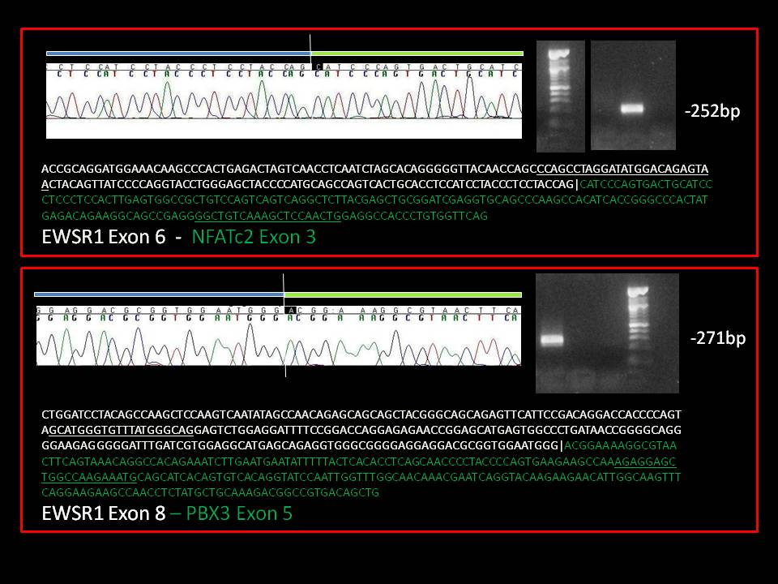
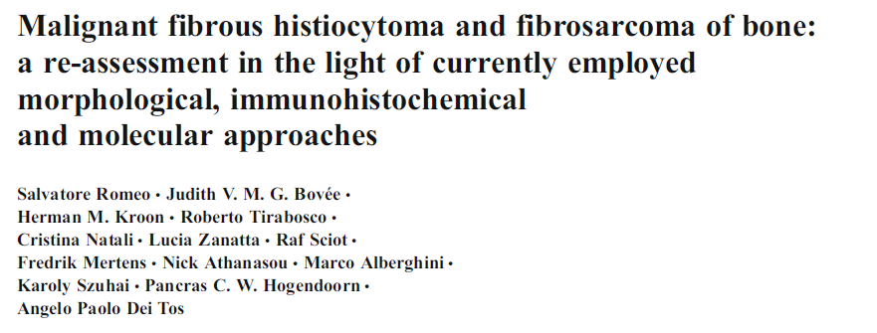
EWSR1 positive: 5/13 (38%)
EWS/FUS +: 6/13 (46%)
Common partners:
PBX1, POU5F1, ZNF444 → negative
Rare partners:
ATF1 → negative
NFATc2 → 1 case (NGS)
PBX3 → 1 case (NGS)

Slide 24
Evolving diagnosis…
Difficult diagnosis / ?? Prognostic factors
FISH profiling may have different very rare partners…
Molecular profiling may be essential for confirmation
Do we deal with one only entity ??
No-traslocated myoepithelioma are the same disease?
Different traslocations necessarily for same disease?
Similar entities in breast / salivary glands…
Is there a role for “limited” NGS as diagnostic confirmation tool?
Open for pathologists!
Notes:
So we can conclude that myoepithelioma is a rare entity but rapidly evolving in recent years
It has been redefined in WHO classification, and for this reason probably incidence will increase in next years
Still differential diagnosis is very difficult as and most of all we have no definite idea of pathologic prognostic and clinical prognostic factors.
FISH profiling is useful but partners genes are very rare; moreover new fusion genes are discover continously – for example a FUS-POU5F1 translocation has been reported in this meeting
This can raise the possibility to consider NGS assessment “limited” to the region of interest as a diagnostic tool (maybe with less expensive analysis)
And finally we still have to understand if myoepithelioma are only one entity, or if non-translocated tumor are different ore even if different translocations are different
We also need to explore the relationship between salivary glands / breast myoepithelioma and the soft tissue ones, at least to try to homogenize treatment if they really are the same entity
So, there is a lot of work waiting for our pathologists.

Slide 25
Acknowledgments
Pathology Dept. INT, Milan
Silvana Pilotti
Gianpaolo Dagrada
Paola Collini
Marta Barisella
“Giorgio Prodi” Cancer Research Dept., Bologna
Maria A. Pantaleo
Medical Oncology Dept. INT, Milan
Silvia Stacchiotti
Paolo G. Casali
Sarcoma Unit INT, Milan
Chiara Colombo
Stefano Radaelli
Alessandro Gronchi

